Slide 1
Data Science
-Day 02

Slide 2
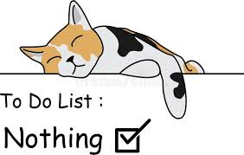
Feedback
-Recieved Response: 2
- Rating: ⅘
-Class was interactive and fun

Slide 3
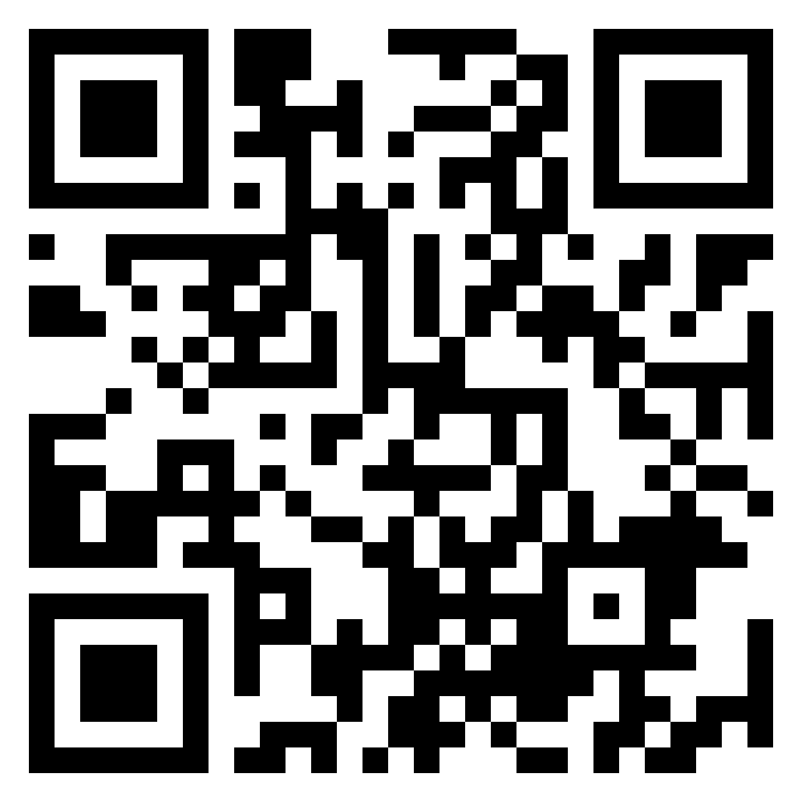
To introduce myself:
AI/ML Engineer
Interests
Javra Software
NLP
Data Sceience
Image Segmentation
About Me:
Love teaching & learning concepts

Slide 4
What is Data Science?
Data science is the practice of using data to understand what happened, why it happened, what is likely to happen next, and what actions to take.
At a basic level, it combines:
statistics for finding patterns
programming for working with data at scale
domain knowledge for asking useful questions
communication for explaining results clearly

Slide 5
Some Key Areas
Descriptive analytics: what happened
Diagnostic analytics: why it happened
Predictive analytics: what may happen
Prescriptive analytics: what should be done
Useful tools often include Python, SQL, spreadsheets, visualization tools, and libraries such as pandas, NumPy, matplotlib, and scikit-learn.

Slide 6
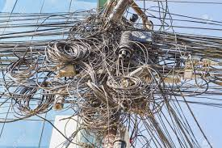
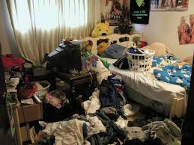
Data wrangling

Slide 7
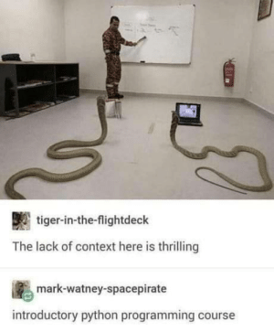
Did you know?
Python’s name was not inspired by the snake but by the British comedy group Monty Python’s Flying Circus

Slide 8
Agendas
Hello World | LOOPs | Methods
Data Types | List , Sets, | range()
Comparison | Functions | lambda

Slide 9
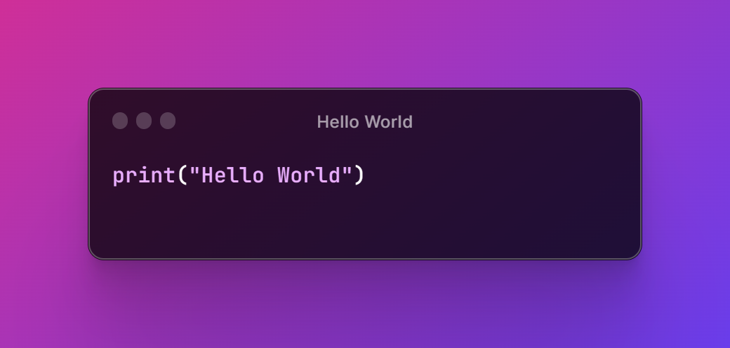
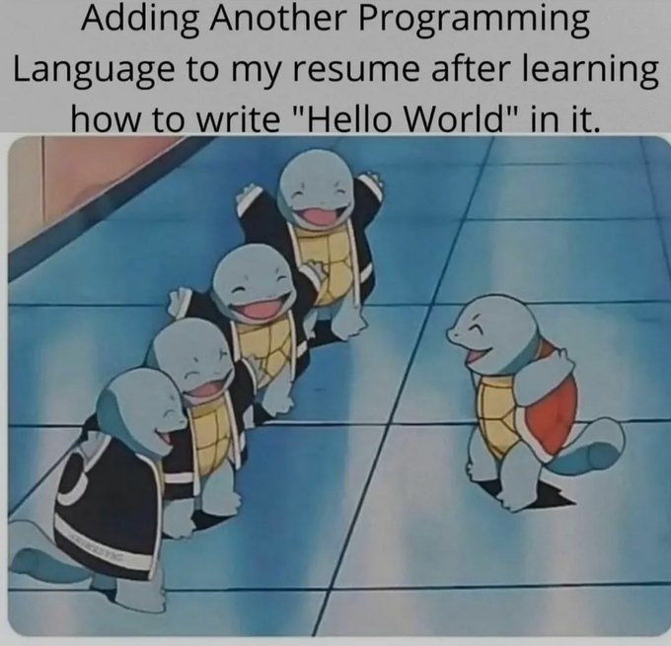
Hello World

Slide 10
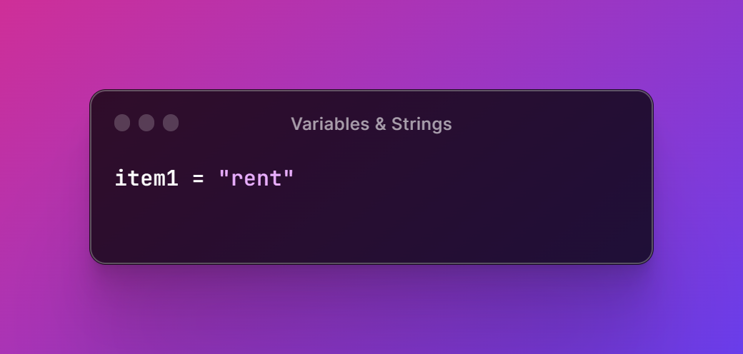
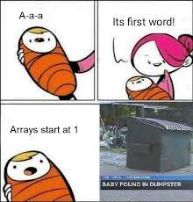
Variables & Strings

Slide 11
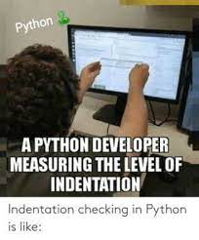
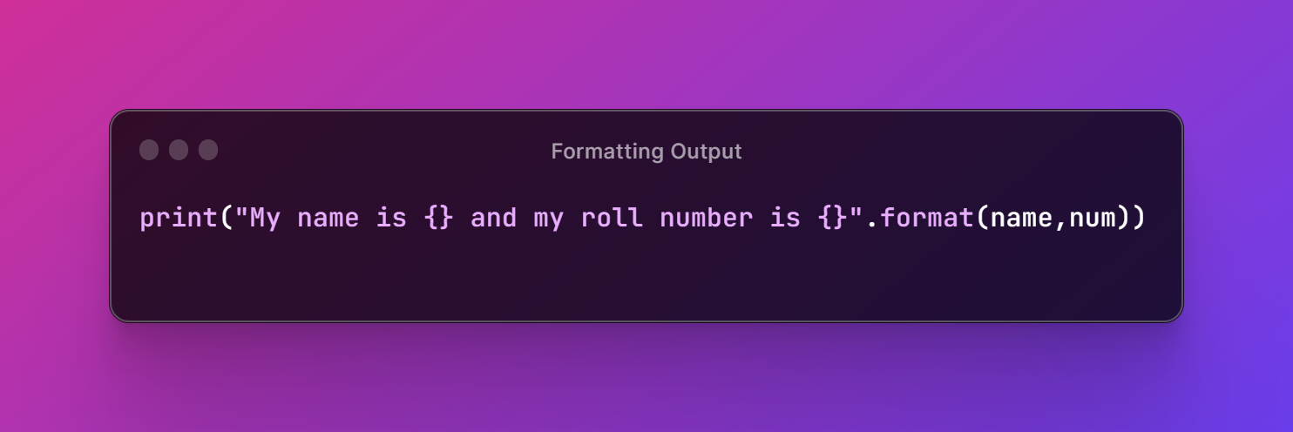
Formatting Output

Slide 12
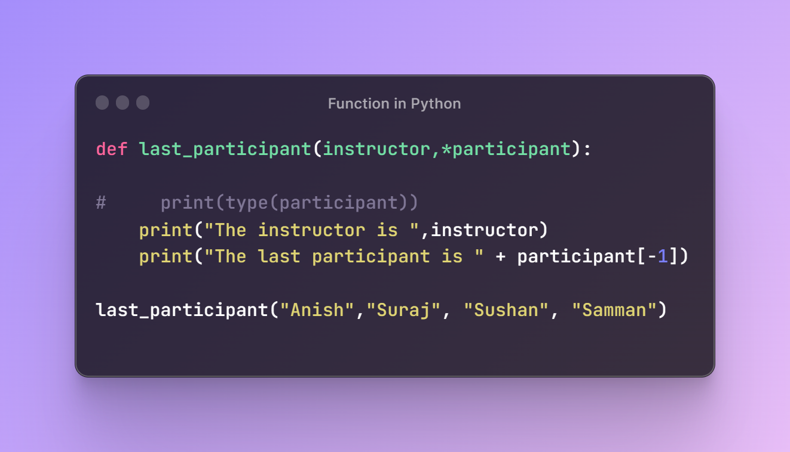
Functions in Python

Slide 13
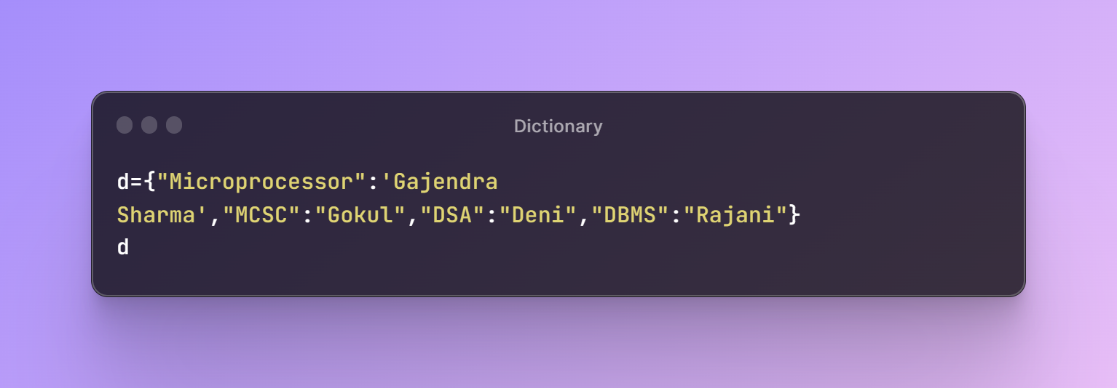
Dictionary
NOTE: Don’t name your dictionary myDict leads to weird conditions

Slide 14
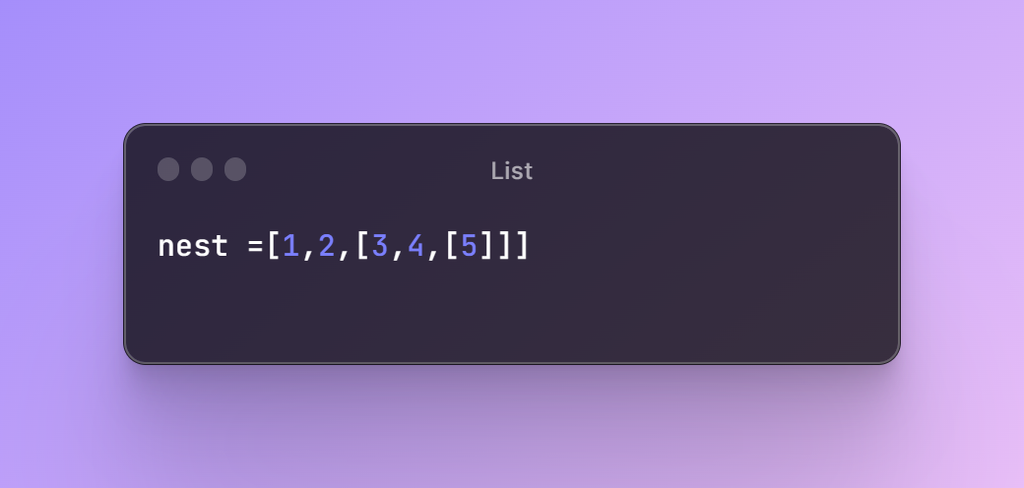
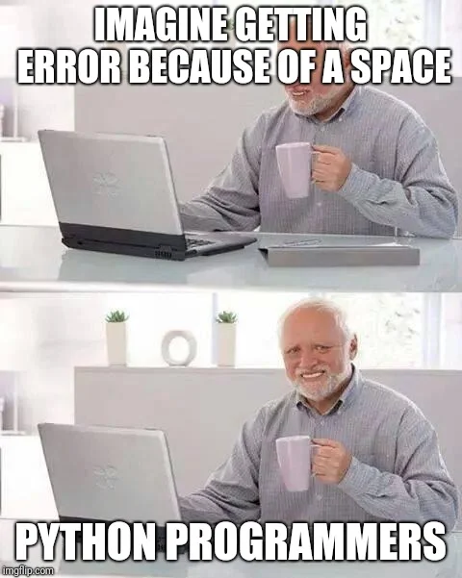
List

Slide 15
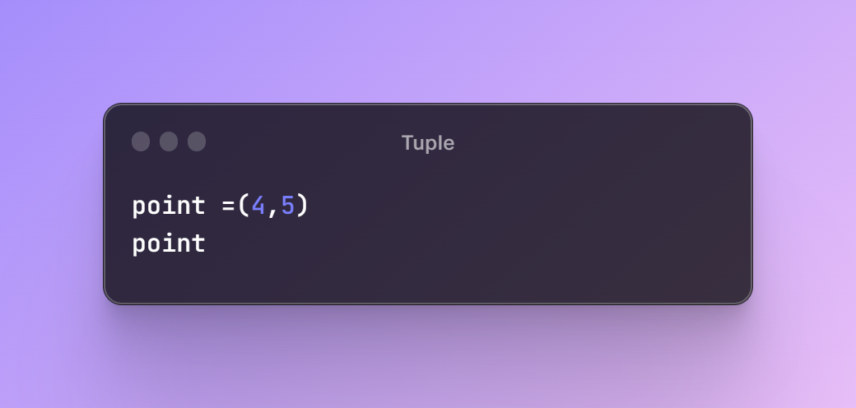
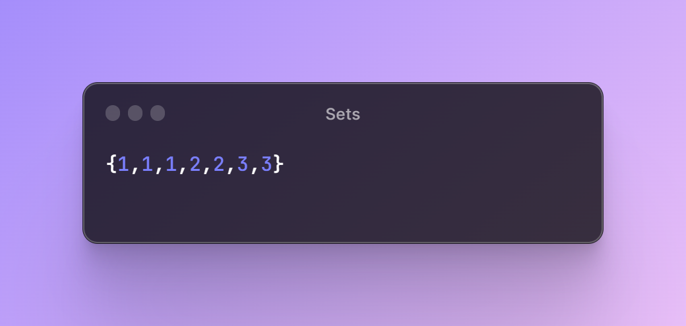
Tuple & Sets

Slide 16
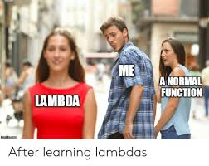
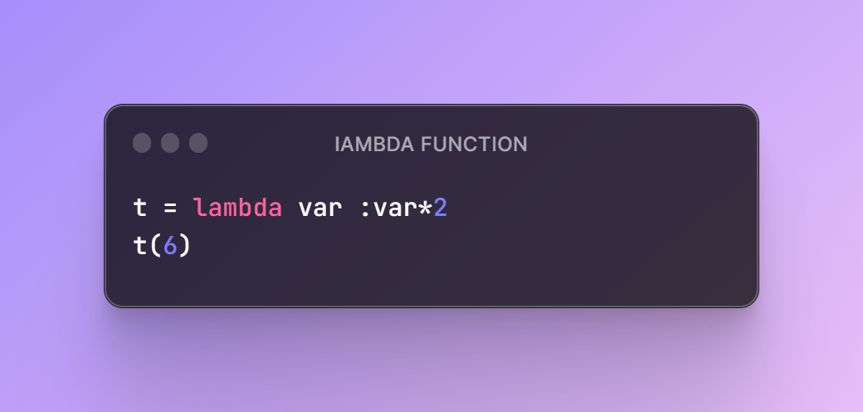
Lambda Function

Slide 17
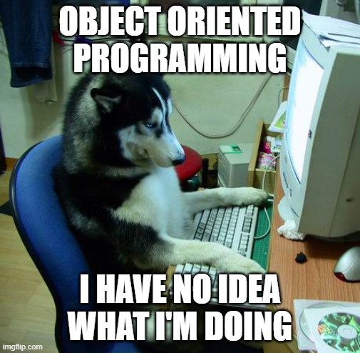
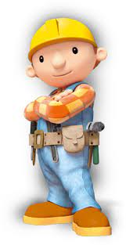
Class

Slide 18
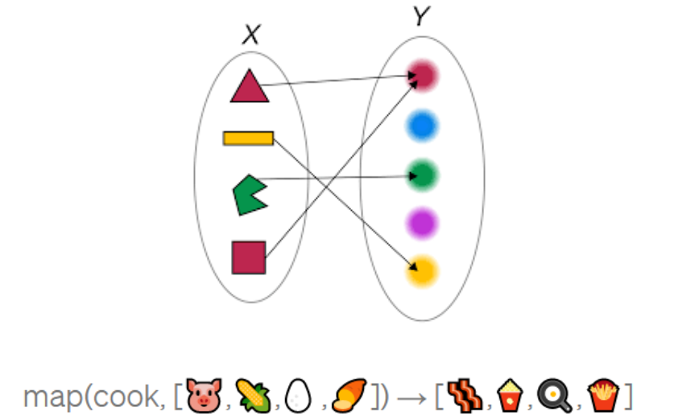
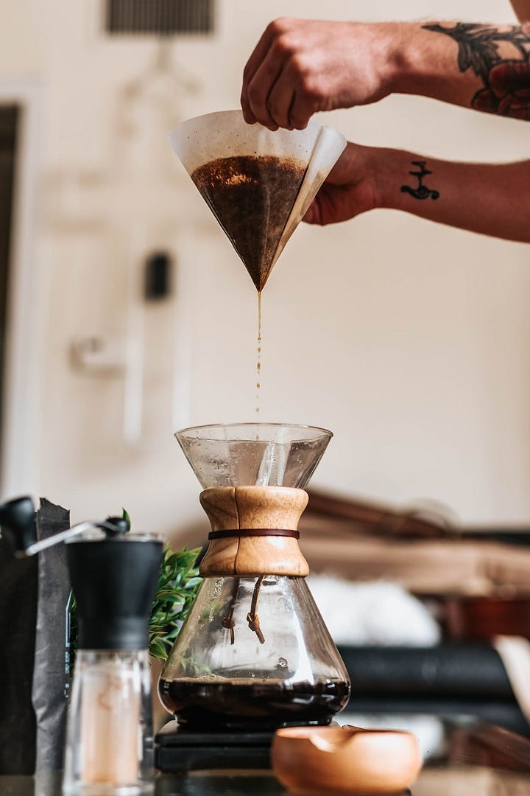
map AND filter

Slide 19
Wap to find a number is prime or composite
WAP to calculate an area of triangle or rectangle

